Slide 1
SAS BI – Maintenance & Support Services
Date : 26 May 2021

Slide 2
EDW Upgrade - Project Status
Time-line | Activity | Status
Week 1-4 | Prod Environment setup | Completed
Week 1-8 | SSIS Packages upgrade and deployment | Completed
Week 5-12 | System Integration Testing | Completed
Week 9-13 | UAT | Completed
Week 11-14 | Performance Testing | Completed
Week 13-15 | Cutover and Migration | On-going
SSIS packages deployment – 275 packages upgradation and deployment completed.
System Integration Testing – All Interfaces (72) SIT completed
User Acceptance Testing – All interfaces UAT sign off received
Performance Testing – Completed
SSRS reports and SQL Agent Jobs configured in Upgrade server. - Completed
Sprint | Sprint Period | Total Packages | Deployment Status in Pre Prod Server
Sprint 1 | 15-Feb - 26-Feb | 82 | 82
Sprint 2 | 01-Mar - 12-Mar | 137 | 137
Sprint 3 | 15-Mar - 26-Mar | 54 | 54
All activities are completed within time-line.

Slide 3
Week 14 Update
UAT release and sign off received.
Performance testing report presented to the BICC and stakeholders and received sign-off.
Cut-over activities – In Progress
Cut-over plan - Walkthrough with all stake-holders - Completed
Parallel EMS queue disabling – Completed
Disable paraller file transfer to upgrade AP02 server – Completed
Imitating all stakeholders regarding EDW upgrade and server downtime - Completed
Pre-Cutover Major On-going activities
Stopped all jobs running in Upgrade server. - Completed
Testing of SSRS reports and SMTP connection. - Completed
All jobs configured in Test UC to be exported into Prod UC. - Completed
STM/TODS interface configuration changes. - Started
CDW interface change plan created for cutover day. - Completed
Copy of AP01(Prod) to AP02(Upgrade) of required files on daily basis - Started
EDW jobs execution in all Upgrade and Prod servers plan preparation. - Completed
DB Restoration of Prod to Upgrade for the Cutover activity - Started
All EDW/CDW relevant jobs monitoring shared with Solarwinds team to start monitoring operation - InProgress

Slide 4
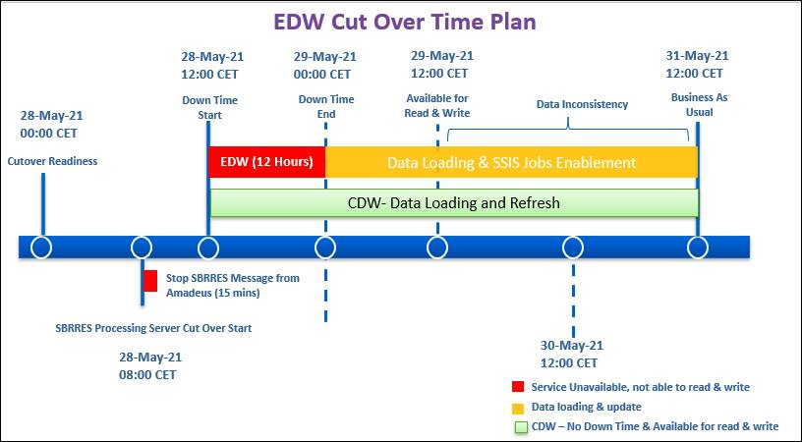
Cutover planning
Change will go live on 28 May 2021.
Proper Documentation for plan is prepared and shared with all Stake holders – EDW Upgrade Cutover Plan_V0.9.
Cutover change approval received.

Slide 5
Challenges
High memory utilization and Performance Issue in EDW DB server - Microsoft recommended few changes which will be implemented after Cutover activity as per reqirement – Closed
CECC – Package will now be running from DB04 and will be automated through Task scheduler. - Completed
After UC jobs migration from TEST UC to PROD UC, for testing purpose executed the job ( SBRRESTOSTG ) - Job failed due to "Not able to access JOBLOG"- Fixed issue by changing the SQL Provider=MSOLEDBSQL to Provider=SQLNCLI11 - Completed
All pre-cutover activity is being performed on daily basis as per plan.
GO-NO-GO Meeting to be held.
15 Feb
15 Mar
10 Apr
07 May
12 May
30 May
11 Jun
Go-Live
Prod Env Setup
SSIS Upgrade
SIT
UAT Support
PROD Cutover
Stabilization Period

Slide 6
Application Maintenance & Support Services - Summary
Application | Alerts Received/Closed | Change Order Planned/Implemented | Incident Opened/Closed
EDW/CDW | 22/22 | 0/0 | 2/2
NAP | 0 | 1/1 | 0/0
BI Portal | 7/7 | 2/0 | 2/2
SLA Definition
Criteria | BI Portal | EDW/CDW/NAP
Severity 1 Resolution Time | 12 hours | 4 hours
Severity 2 Resolution Time | 24hours | 8hours
RCA- Severity 1 cause to SAS | 10 days | 10 days
Only Sev4 incidents were raised.
No Sev1,Sev2,Sev3 incidents were raised.

Slide 7
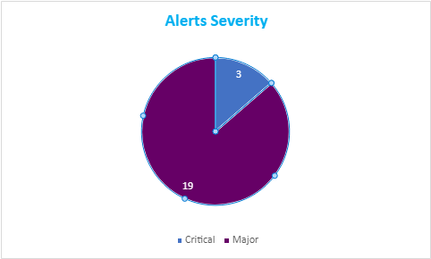
EDW/CDW – Alerts Summary
Date Range | No. Of Alerts | No. of Incidents
13-May-21 TO 26-May-21 | 22 | 2
28-Apr-21 TO 12-May-21 | 23 | 0
Total of 22 alerts received
10 are parent alert. 12 are Child Alerts

Slide 8
EDW/CDW – RCA for Critical Alerts
Interface Name ​ | Description of Alert | Cause ​ | Action Taken/Reduction Plan ​ | Action Taken By
DCSFM | Interface – DCSFM PWA50DCSFMTOFNLS_WF failed (SASINC0170889) | PWA50DCSFMTOFNLS_WF failed due corrupt message received . | Deleted corrupt data and Rerun the flow and flow executed successfully. | Ankesh
CRF | Interface – CRF PWA85CRFDAILY_WF failed (SASINC0170550) | Earlier job PWA3000N took longer time to complete. So it's TM failed in the workflow | Re-ran the Tm and flow completed successfully | Sathish
BFULOAD | Interface – BFU PWA019BFUSLOAD_WF failed (SASINC0170520) | Earlier job PWA3000N took longer time to complete. So it's TM failed in the workflow | Re-ran the Tm and flow completed successfully | Rakshit

Slide 9
EDW/CDW – Fix for Major Alerts
S.NO​ | Interface | Issue Description​ | Action Taken​ | Date | Action Taken By
1 | CDWLAND | PWA55CDWLANDAC_WF Failed due to File not received from SIRAX | . Placed previous day file and reran the flow. Data loading was successful. | 12-May-2021 | Prashant
2 | SIRAX | PWA06SIRAXFL_WF Failed due to renaming multiple Company files | Re-ran flow with latest files in SIRAX location. Took backup of already created files. Flow went successful. | 13-May-2021 | Naveen
3 | SIRAX | PWA06SIRAXFL_WF No files were received for the date 15-05-2021 | Force finished the job as no file received for that day. | 15-May-2021 | Rakshit
4 | CDWLOAD | PWA55CDWLOADDWAC_WF TM Failed due to patching activity | Force Finished the failed TM. Re-Ran flow. Flow was successfully completed | 16-May-2021 | Naveen

Slide 10
EDW/CDW – Fix for Major Alerts contd..
S.NO​​ | Interface​ | Issue Description​​ | Action Taken​​ | Date​ | Action Taken By​
5 | SIRAX | PWA06SIRAXFL_WF TM Failed due to file not received | Force finished the job as no files were received on that day. | 16-May-2021 | Prashant
6 | CDWLOAD | PWA55CDWLOADDW_WF Failed due to duplicate date issue | Deleted the duplicate data re-ran the flow and Flow was successfully completed. | 19-May-2021 | Sathish
7 | EXCERPT | PWA090EXCERPTPS_WF Failed due to temporary table issue | Re-run the flow and flow completed successfully | 20-May-2021 | Archit
All Alerts have been closed within timelines

Slide 11
EDW/CDW – Change Order Summary
S. No​ | CO # ​ | Requirement No​ | Status​ | Implemented On | Assigned To
1. | NA | NA | NA | NA | NA

Slide 12
NAP– Critical/Major Incidents/Alerts
No incidents..
No critical incident received in any pipeline.

Slide 13
NAP– Change Order Summary
S.No | CO # | Change Order Description​​​ | Status​ | Implemented/ Planned On | Remarks
1. | SASCHG0039313 | Deployed FlightOpsFlight Rotation) pipeline to provide continuous feed(&historical load) to the staging table. | Completed | 17-May-21 | Change implemented successfully.

Slide 14
NAP– Operational Tracker
S. No​​ | Description​​ | Action Taken​/Remarks​ | Planned End date​ | Status​
1. | Incident(2104270050002463) SIRAX pipeline failed on 26 April. | failed while scaling up the azure synapse . Raised separate MS support ticket for further investigation. |  | In-progress
2. | CWEUPNAPAP01 : Patching Activity | Sirax main pipeline trigger to be updated to 02:00 UTC on 4th Saturday after the execution. Post patching - verification of Integrations services on CWEUPNAPAP01 Server. Rervert the timing of Sirax main pipeline to 21:00 UTC | 23-may-21 | Completed

Slide 15
BI Portal – Alerts Summary
Date Range | No. Of Alerts
12/May/2021-25/May/2021 | 7
28/Apr/2021-11/May/2021 | 11
JUAN and TODS are hourly flow so they were successful in next run.​
Hermes flow exited due to zero delay messages were received.
FADS flow was deadlock issue. It was rerun and it was successful
For partner flows error was shared to stakeholders.
Juan JSON and TODS were hourly flow. Next run was successful.

Slide 16
BI Portal- Incident
Incident No. & Severity | Description​ | Action Taken​ | Raised By | Raised On | Closed On | Status | Assigned To
SASINC0171307 | Hans requested to provide access on 10.33.150.27 | Coordinated with AO team to provide required read access | Hans | 21-May-21 | 21-May-21 | Closed | TCS AM BI Portal/TCS IS AO
SASINC0171309 | Viya dependent flows failed due to stopped services | When services were up all required flows were rerun | Service now | 22-May-21 | 22-May-21 | Closed | TCS AM BI Portal

Slide 17
BI Portal– Alerts Drilldown
S.NO​ | Interface Name​ | Incident No | Issue Description​ | Action Taken ​ | Date | Assigned To
1 | NFV | SASINC0171313 | Dataset got corrupted | Dataset was restored and flow was rerun | 17-May-2021 | Archit Rastogi
2 | Operation Performance | SASINC0171310 | Deadlock on TURNAROUND_MATRIX | SAS dataset was under deadlock causing failure. Job was rerun and completed successfully | 24-May-2021 | Archit Rastogi

Slide 18
BI Portal – Change Order
S. No​ | CO # ​ | Requirement No​ | Implemented On | Status​
1 | SASCHG0039403 | To start a new tracker ‘Pre Travel’ as part of existing Confirmit surveys | 27-May-2021 | Open
2 | SASCHG0039269 | Viya decommission | 03-May-2021 | Open

Slide 19
S.No | Description | Raised by | Action Taken​ | Date | Status | Assigned
1 | Read/Write access to Anders Kleist (17086) on \\10.33.150.26\Cloudshop | Warren | Requested the AO team As suggested by AO raised SR to add user to group GS_IT_SASBIShare_AM | 24-May-2021 | Closed | Archit

Slide 20
KSS Session
KSS Topic | Domain | Associate | Planned Date | Status
Running packages in SQL Server | SSIS ( Integration Services ) | Satish | 25-May | Completed
Star and snowflake schemas | SSAS ( Analysis Services) | Satish | 25-May | Completed
Fact and Dimension tables | SSAS ( Analysis Services) | Satish | 25-May | Completed
Creating a data warehouse | SSAS ( Analysis Services) | Naveen | 6-June | Planned
Designing tables and views | SSAS ( Analysis Services) | Naveen | 6-June | Planned
Rebuilding columnstore indexes | SSAS ( Analysis Services) | Naveen | 6-June | Planned
Cubes design and development | SSAS ( Analysis Services) | Ankesh | 26-May | Completed
Partitioning and Storage Mode | SSAS ( Analysis Services) | Ankesh | 5-June | Planned
Aggregation Design | SSAS ( Analysis Services) | Ankesh | 5-June | Planned
CAP theorem | System Design and Architecture | Ayush | 27-May | Planned
Database sharding and partioning | System Design and Architecture | Ayush | 27-May | Planned
Horizontal Scale vs Vertical scale | System Design and Architecture | Ayush | 31-May | Planned
NO SQL vs SQL | System Design and Architecture | Ayush | 31-May | Planned
Load balancers/ Load balancing | System Design and Architecture | Ayush | 1-June | Planned
Messaging Queues | System Design and Architecture | Ayush | 1-June | Planned

